Slide 1
Spellfire
By Kevin Naranjo and Will Rusk

Slide 2
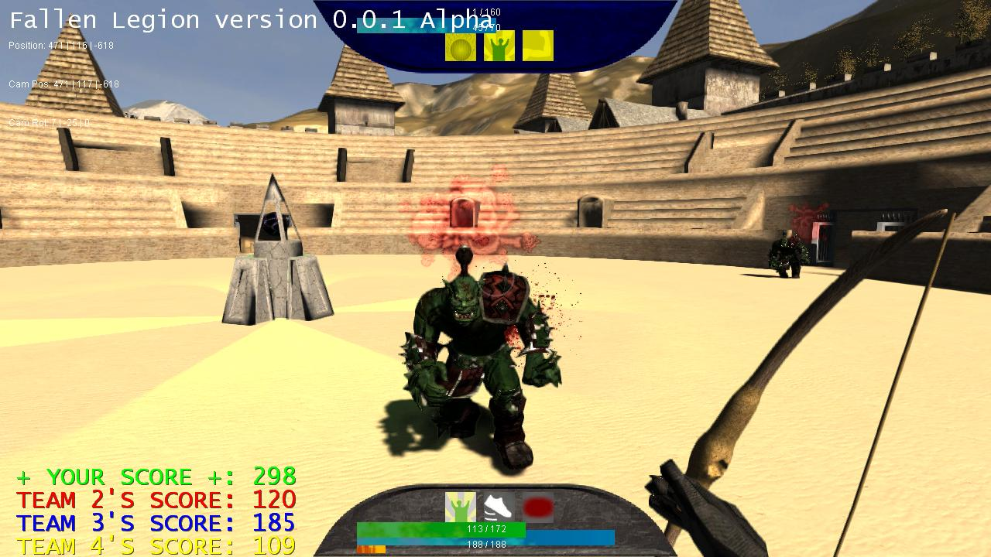
Description
Fight enemies in the arena
Wield powerful spells and magicks to defeat your foes
Enemies grow stronger with every round
Unlock more abilities as you progress

Slide 3
Minimum Viable Product
Player can shoot projectiles to damage enemies
Enemies move towards and attack player
At least one fully animated enemy type
Playable FPS (~20)
Textured scene and enemies
Player is static in center of the arena

Slide 4
Desired Deliverable Features
Sound
Different types of enemies and attacks
High quality animations
Particle effects
Good performance (30+ fps)
Player can move around freely

Slide 5
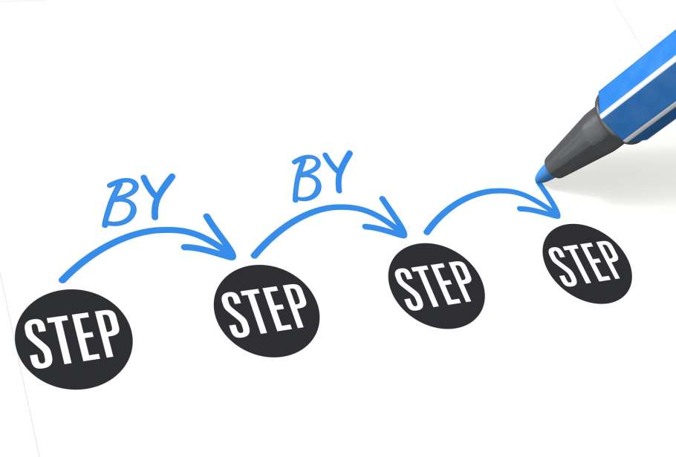
Our Approach
Create level geometry, lighting and render using shaders
Add placeholder enemy geometry and player geometry
Add game logic for player interaction, gameplay, and enemies
Create finalized enemy models, animations

Slide 6
Division of Labor
Kevin
Game Logic
GUI
Texture Design
Optimization
Will
Level Design
Animation & Model Design
Animation Logic
Optimization

Slide 7

Progress So Far
Animation technique research
Skeletons vs. many plys
playSound() c++
Model + sound resources
Shamelessly ripped inspired from other games

